Slide 1


Cybersecurity through an Ontological Lens
John Beverley
Assistant Professor, University at Buffalo
Co-Director, National Center for Ontological Research
Affiliate Faculty, Institute of Artificial Intelligence and Data Science

Slide 2
Outline
SPARQL
MITRE D3FEND
Semantic Web Vulnerabilities
Formal Verification Meets Ontology Enginering

Slide 3
Outline
SPARQL
MITRE D3FEND
Semantic Web Vulnerabilities
Formal Verification Meets Ontology Enginering

Slide 4
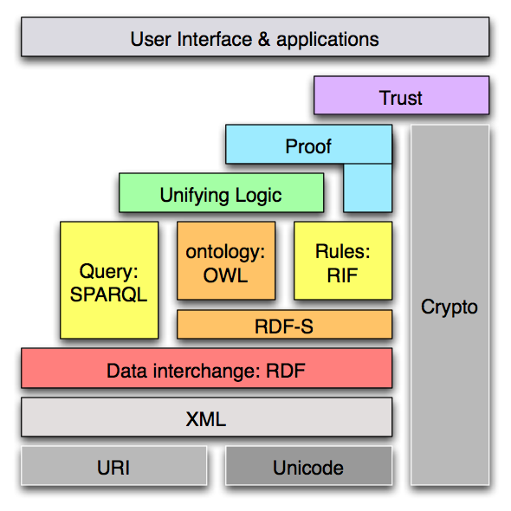
Semantic Web Stack
“SPARQL” stands for:
SPARQL Protocol
And RDF
Query Language
SPARQL is a:
Core semantic web technology
Query language for RDF
A protocol for transmitting queries over HTTP

Slide 5
Semantic Web Stack
“SPARQL” stands for:
SPARQL Protocol
And RDF
Query Language
SPARQL is a:
Core semantic web technology
Query language for RDF
A protocol for transmitting queries over HTTP

Slide 6
Query Languages
Database query languages are languages used to extract from and manipulate data in information systems
Traditionally, data was stored in relational databases, which were fixed, built on the closed world assumption, but somewhat easy to query using well-known languages like SQL
RDF databases are flexible, adopt the open world assumption, and querying requires a language suited to these features

Slide 7
SPARQL Query Language
SPARQL is a query language for RDF databases
SPARQL shares much in common with query languages like SQL, and many differences
SPARQL queries focus on what users want to know about the data; SQL queries focus on how the data is structured
You will become a SPARQL NinjaTM by course end

Slide 8
Semantic Web Stack
“SPARQL” stands for:
SPARQL Protocol
And RDF
Query Language
SPARQL is a:
Core semantic web technology
Query language for RDF
A protocol for transmitting queries over HTTP

Slide 9
HTTP Protocol
SPARQL is protocol that specified how to send queries over the web to an endpoint using HTTP requests
A protocol in this context is a set of rules that prescribe how parties communicate
HTTP is a protocol defined between a client – software that reads data from a server – and a server – where the data is stored

Slide 10
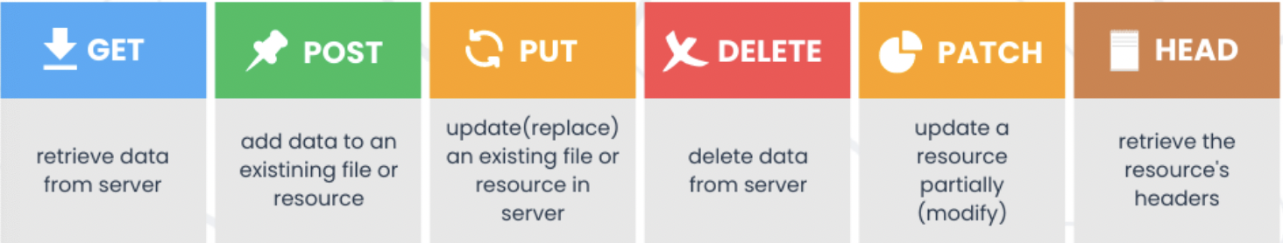
HTTP Protocol
HTTP is a request-response protocol, a client has to send a request for data before the server will respond with that data
HTTP request methods:

Slide 11
SPARQL Protocol
Unlike other query languages, SPARQL is designed with a protocol that enables it to natively query over HTTP requests
What this means is that data exposed by SPARQL on any server can be queried by any SPARQL client
In contrast, query languages like SQL can only be queried locally
SPARQL allows, for example, combining data from many different sources, dynamically

Slide 12
Semantic Web Stack
“SPARQL” stands for:
SPARQL Protocol
And RDF
Query Language
SPARQL is a:
Core semantic web technology
Query language for RDF
A protocol for transmitting queries over HTTP

Slide 13
SPARQL Query Structure
PREFIX rdfs: http://www.w3.org/2000/01/rdf-schema#
SELECT ?subject ?label WHERE { ?subject rdfs:label ?label . }

Slide 14
SPARQL Query Structure
PREFIX rdfs: http://www.w3.org/2000/01/rdf-schema#
SELECT ?subject ?label WHERE { ?subject rdfs:label ?label . }
Declare the namespace

Slide 15
SPARQL Query Structure
PREFIX rdfs: http://www.w3.org/2000/01/rdf-schema#
SELECT ?subject ?label WHERE { ?subject rdfs:label ?label . }
Declare the namespace
then return any data...

Slide 16
SPARQL Query Structure
PREFIX rdfs: http://www.w3.org/2000/01/rdf-schema#
SELECT ?subject ?label WHERE { ?subject rdfs:label ?label . }
Declare the namespace
then return any data...
...that satisfies the condition...

Slide 17
SPARQL Query Structure
PREFIX rdfs: http://www.w3.org/2000/01/rdf-schema#
SELECT ?subject ?label WHERE { ?subject rdfs:label ?label . }
Declare the namespace
then return any data...
...that satisfies the condition...
...bears rdfs:label
to something.

Slide 18
SPARQL Query Structure
PREFIX rdfs: http://www.w3.org/2000/01/rdf-schema#
SELECT ?subject ?label WHERE { ?subject rdfs:label ?label . }
Returns list of subjects and their labels
Declare the namespace
then return any data...
...that satisfies the condition...
...bears rdfs:label
to something.

Slide 19
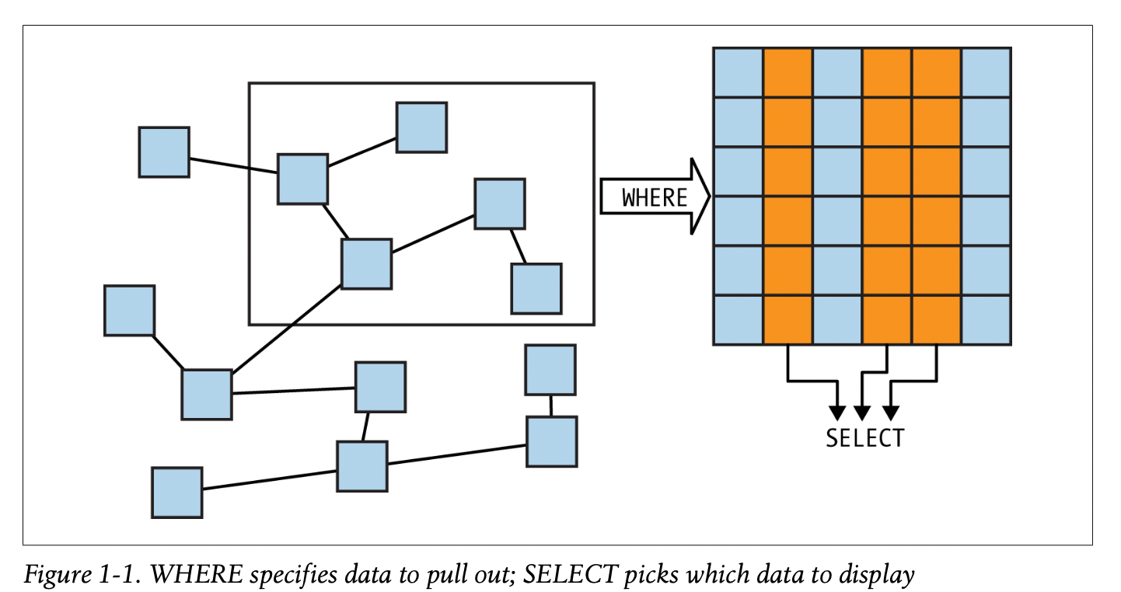
SELECT and WHERE

Slide 20
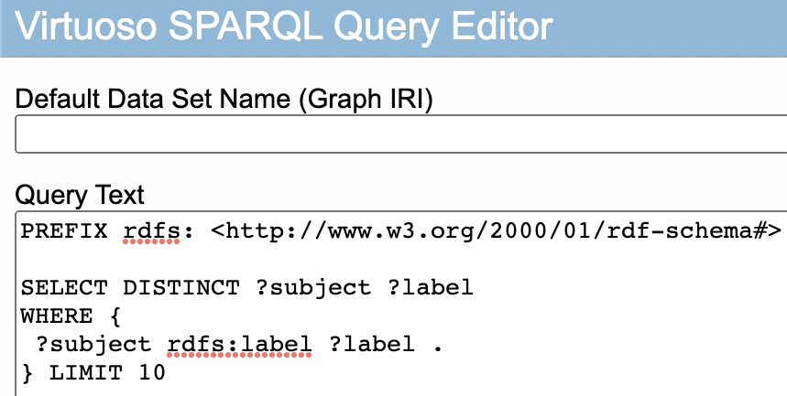
Endpoint https://makg.org/sparql

Slide 21
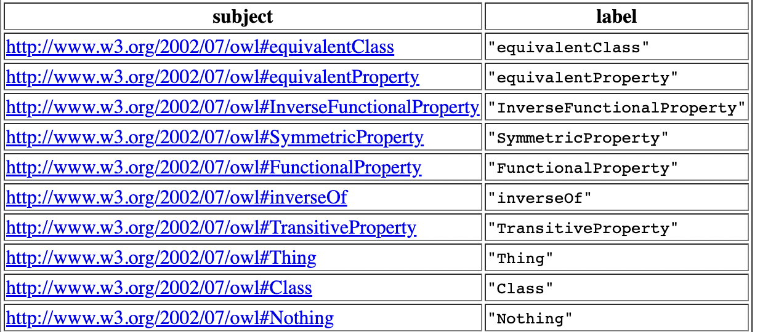
Endpoint https://makg.org/sparql

Slide 22
OPTIONAL
Because the basic unit of RDF is a triple, SPARQL queries by default return only triples that satisfy conditions in the WHERE clause
That is, partial matches are not returned by default
Consider, you might want to return the birth and death dates of everyone in a database...

Slide 23
OPTIONAL
SELECT ?subject ?birthday ?deathday WHERE { ?subject ex:has_birthday ?birthday ; ex:has_deathday ?deathday . }

Slide 24
OPTIONAL
SELECT ?subject ?birthday ?deathday WHERE { ?subject ex:has_birthday ?birthday ; ex:has_deathday ?deathday . }
Suppose the database is of my family, and includes my grandmother’s birthday and deathday

Slide 25
OPTIONAL
SELECT ?subject ?birthday ?deathday WHERE { ?subject ex:has_birthday ?birthday ; ex:has_deathday ?deathday . }
This query will return that information for my grandmother, but it will only return information for individuals who have both a birthday and a deathday

Slide 26
OPTIONAL
SELECT ?subject ?birthday ?deathday WHERE { ?subject ex:has_birthday ?birthday ; ex:has_deathday ?deathday . }
It is plausible, however, that one might want to return individuals and their birthdays, even if they are still alive...

Slide 27
OPTIONAL
SELECT ?subject ?birthday ?deathday WHERE { ?subject ex:has_birthday ?birthday . OPTIONAL { ?subject ex:has_deathday ?deathday . } }
OPTIONAL operates like a conditional; return everyone with a birthday and if they have a deathday, return that too

Slide 28
FILTER
The FILTER keyword restricts the conditions in the WHERE clause using boolean and other functions
PREFIX ex: <https://example.com/> SELECT ?person ?name WHERE { ?person rdf:type ex:Person ; ex:name ?name ; ex:age ?age . FILTER (xsd:integer(?age) >= 18)
}

Slide 29
FILTER
The FILTER keyword restricts the conditions in the WHERE clause using boolean and other functions
PREFIX ex: <https://example.com/> SELECT ?person ?name WHERE { ?person rdf:type ex:Person ; ex:name ?name ; ex:age ?age . FILTER (xsd:integer(?age) >= 18)
}
Declare the namespace

Slide 30
FILTER
The FILTER keyword restricts the conditions in the WHERE clause using boolean and other functions
PREFIX ex: <https://example.com/> SELECT ?person ?name WHERE { ?person rdf:type ex:Person ; ex:name ?name ; ex:age ?age . FILTER (xsd:integer(?age) >= 18)
}
Declare the namespace
SELECT variables...

Slide 31
FILTER
The FILTER keyword restricts the conditions in the WHERE clause using boolean and other functions
PREFIX ex: <https://example.com/> SELECT ?person ?name WHERE { ?person rdf:type ex:Person ; ex:name ?name ; ex:age ?age . FILTER (xsd:integer(?age) >= 18)
}
Declare the namespace
SELECT variables...
...WHERE...

Slide 32
FILTER
The FILTER keyword restricts the conditions in the WHERE clause using boolean and other functions
PREFIX ex: <https://example.com/> SELECT ?person ?name WHERE { ?person rdf:type ex:Person ; ex:name ?name ; ex:age ?age . FILTER (xsd:integer(?age) >= 18)
}
Declare the namespace
SELECT variables...
...WHERE...
...someone is a Person...

Slide 33
FILTER
The FILTER keyword restricts the conditions in the WHERE clause using boolean and other functions
PREFIX ex: <https://example.com/> SELECT ?person ?name WHERE { ?person rdf:type ex:Person ; ex:name ?name ; ex:age ?age . FILTER (xsd:integer(?age) >= 18)
}
Declare the namespace
SELECT variables...
...WHERE...
...someone is a Person...
...with a name...

Slide 34
FILTER
The FILTER keyword restricts the conditions in the WHERE clause using boolean and other functions
PREFIX ex: <https://example.com/> SELECT ?person ?name WHERE { ?person rdf:type ex:Person ; ex:name ?name ; ex:age ?age . FILTER (xsd:integer(?age) >= 18)
}
Declare the namespace
SELECT variables...
...WHERE...
...someone is a Person...
...with a name...
...and age...

Slide 35
FILTER
The FILTER keyword restricts the conditions in the WHERE clause using boolean and other functions
PREFIX ex: <https://example.com/> SELECT ?person ?name WHERE { ?person rdf:type ex:Person ; ex:name ?name ; ex:age ?age . FILTER (xsd:integer(?age) >= 18)
}
Declare the namespace
SELECT variables...
...WHERE...
...someone is a Person...
...with a name...
...and age...
...but keep only the
people over 18.

Slide 36
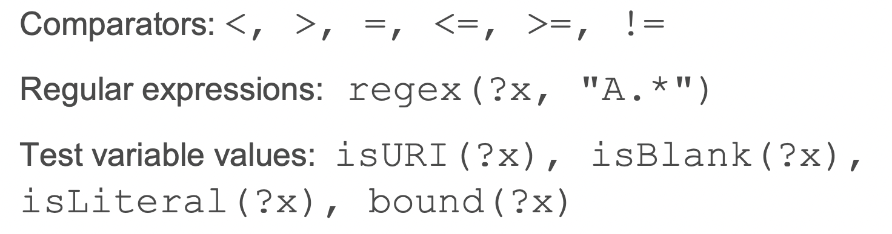
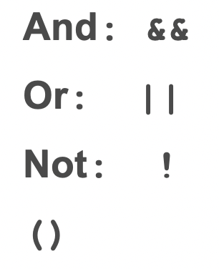
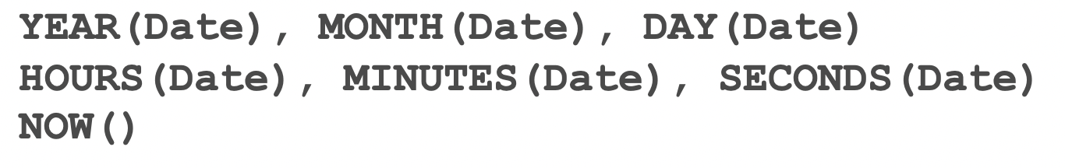
FILTER
FILTER functions include:

Slide 37
FILTER
Logical combinations of filter clauses, e.g.
FILTER (xsd:integer(?age)>18
&& xsd:integer(?age)<25)
FILTER functions include:

Slide 38
FILTER
Filter functions to restrict results, e.g.
FILTER (regex(?x, “hello”, “i”))
FILTER functions include:

Slide 39
Outline
SPARQL
MITRE D3FEND
Semantic Web Vulnerabilities
Formal Verification Meets Ontology Enginering

Slide 40
Jargon
Advanced persistent threat
A cybersecurity countermeasure is any process or tech- nology developed to negate or offset offensive cyber activities
CVE database

Slide 41
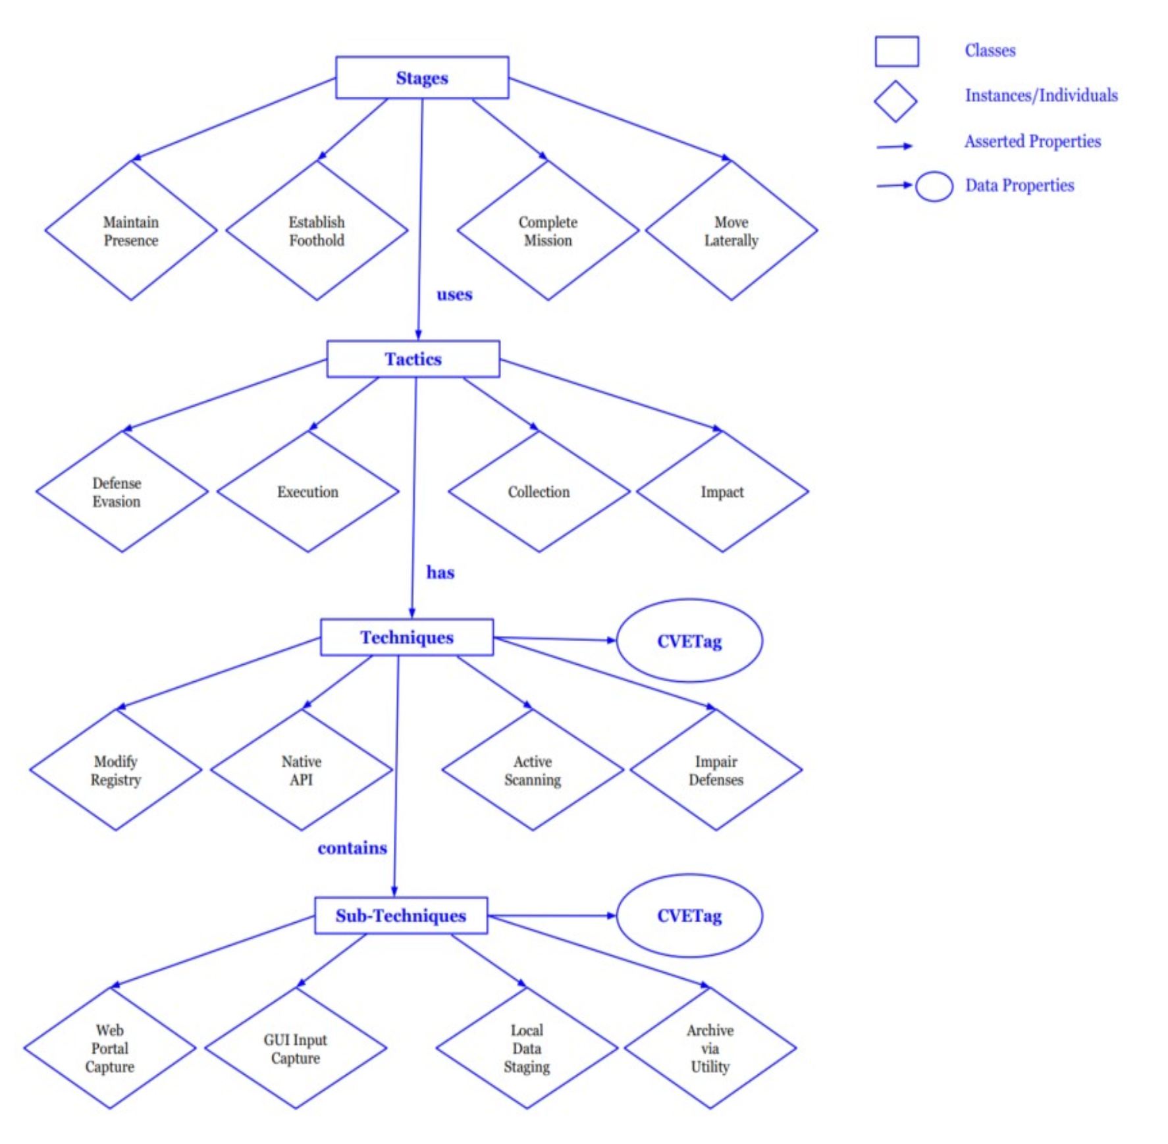
Cybersecurity Attack
Stages of attack are distinct from deployed tactics and techniques of those stages
As well as sub-techniques, etc.

Slide 42
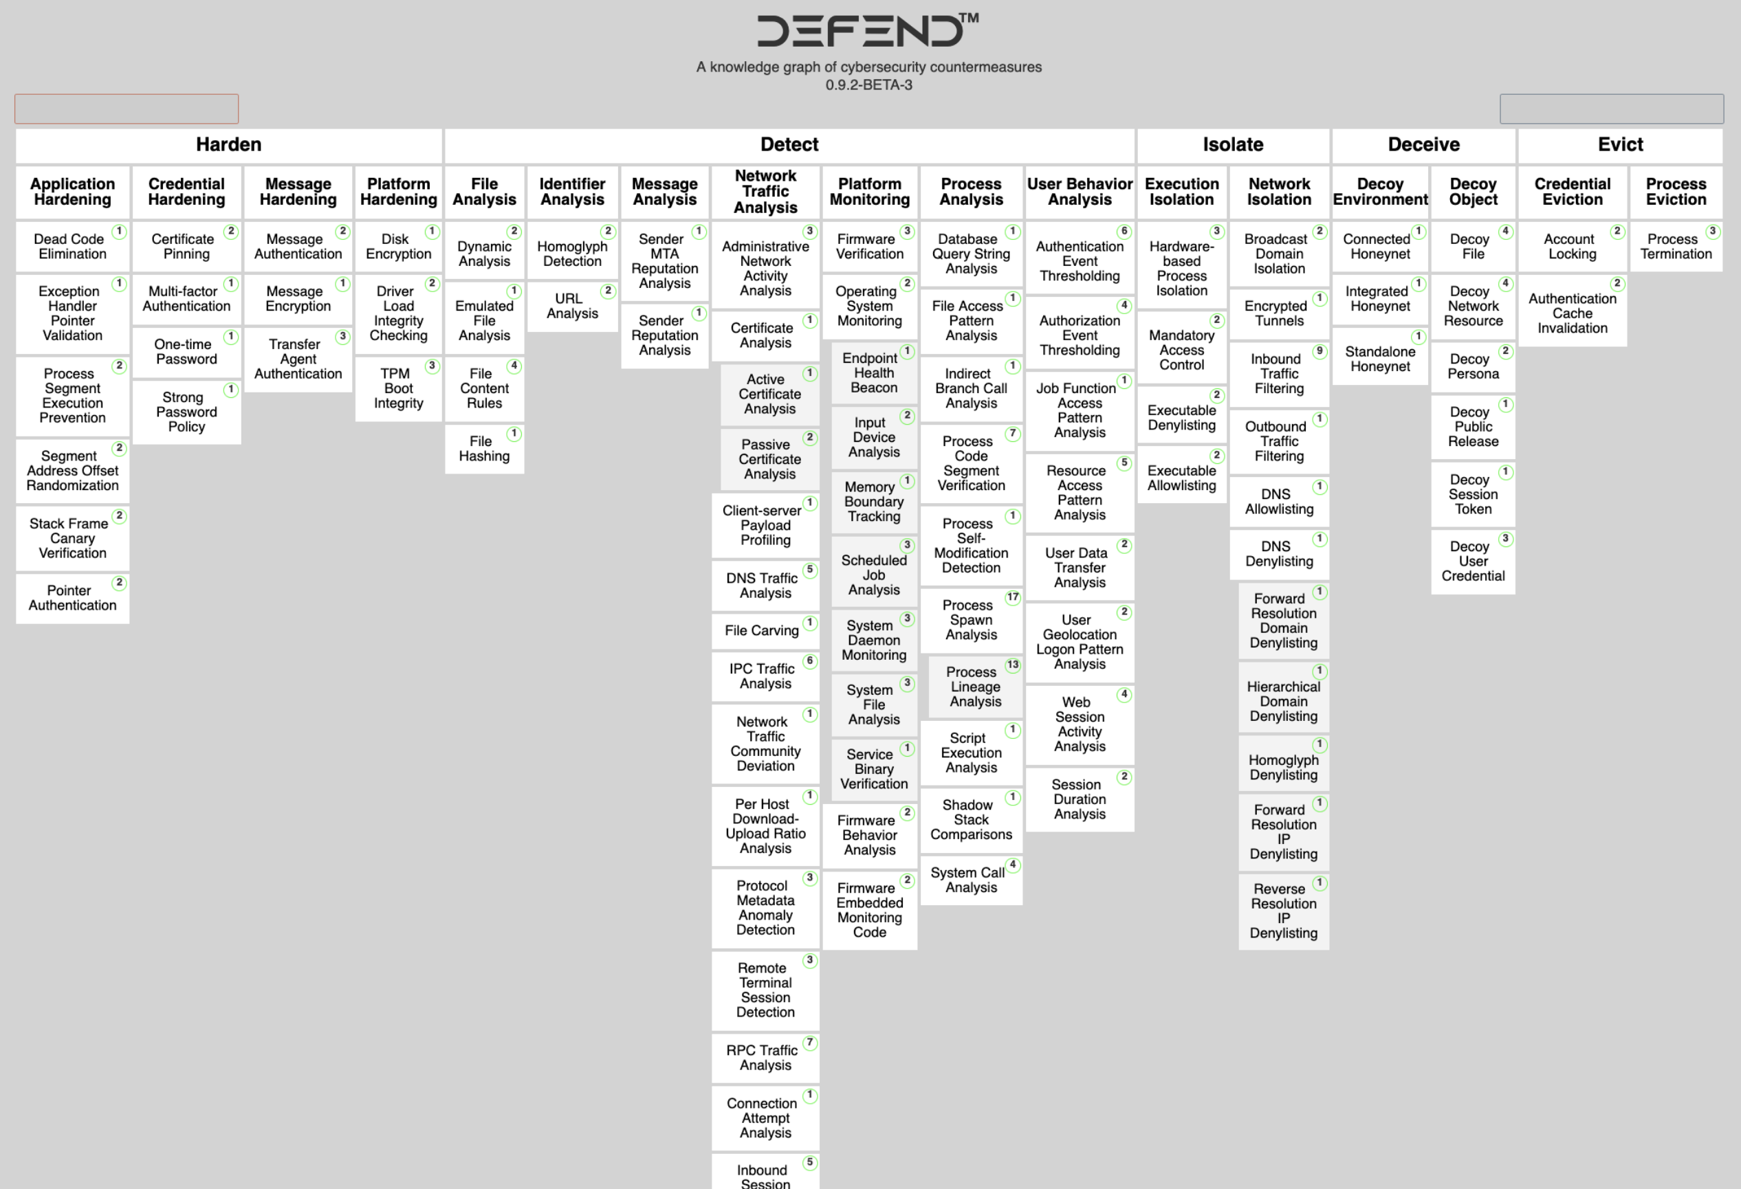

Slide 43
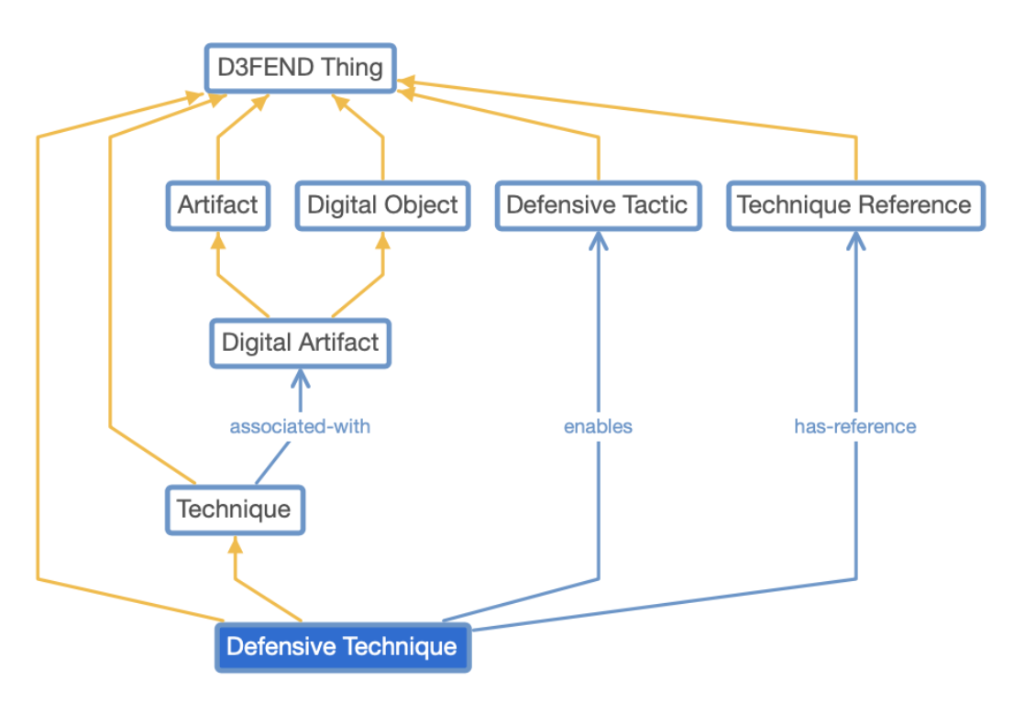
D3FEND
D3FEND’s longer-term goals are to (1) create a sustain- able knowledge framework for characterizing and relating cybersecurity countermeasure technology; and (2) accelerate knowledge discovery and acquisition efforts required to keep pace with technological changes in the cyber domain.

Slide 44
D3FEND
John Sweet: “If you can replace a term with “thingy” then you don’t understand it.”
D3FEND’s longer-term goals are to (1) create a sustain- able knowledge framework for characterizing and relating cybersecurity countermeasure technology; and (2) accelerate knowledge discovery and acquisition efforts required to keep pace with technological changes in the cyber domain.

Slide 45
D3FEND
Let’s go spelunking...
D3FEND’s longer-term goals are to (1) create a sustain- able knowledge framework for characterizing and relating cybersecurity countermeasure technology; and (2) accelerate knowledge discovery and acquisition efforts required to keep pace with technological changes in the cyber domain.

Slide 46
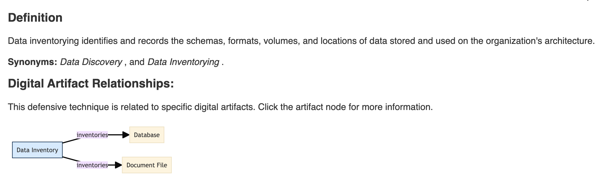
Data Inventory
Definition is about a process, but label suggests actual inventory

Slide 47
Data Inventory
Relationships section suggests data inventorying is a defensive technique...

Slide 48
Data Inventory
Let’s continue our adventure...

Slide 49
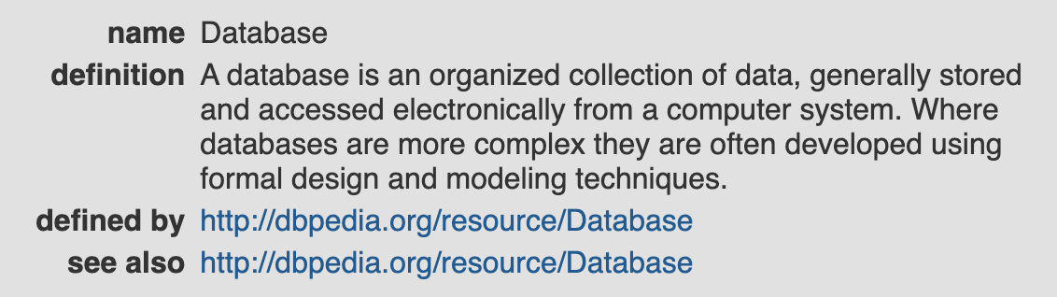
Database
OK...

Slide 50
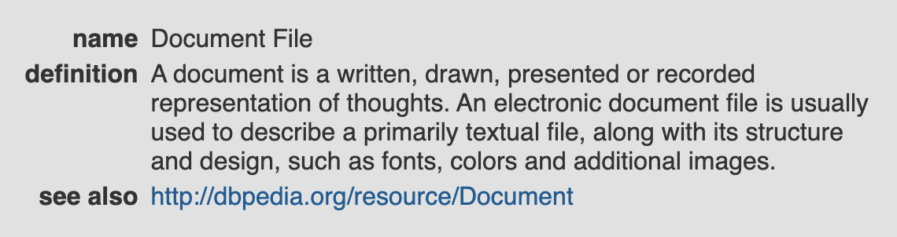
Document File
Back to describing continuant-like entities rather than processes...

Slide 51
Document File
I believe I’ve spotted the culprit...

Slide 52

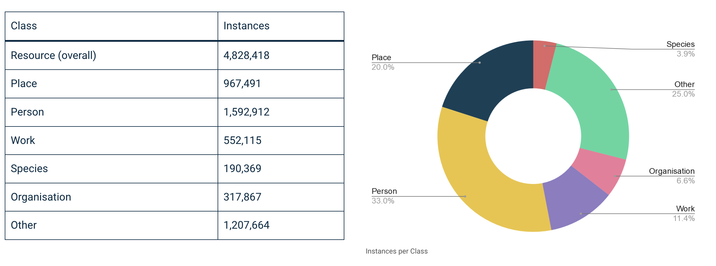

Slide 53
Group Exercise
Gather into small groups; navigate to DBPedia and navigate to the MITRE D3FEND landing page
MITRE D3FEND is built on the DBPedia knowledge base
Explore the D3FEND definitions provided by DBPedia

Slide 54
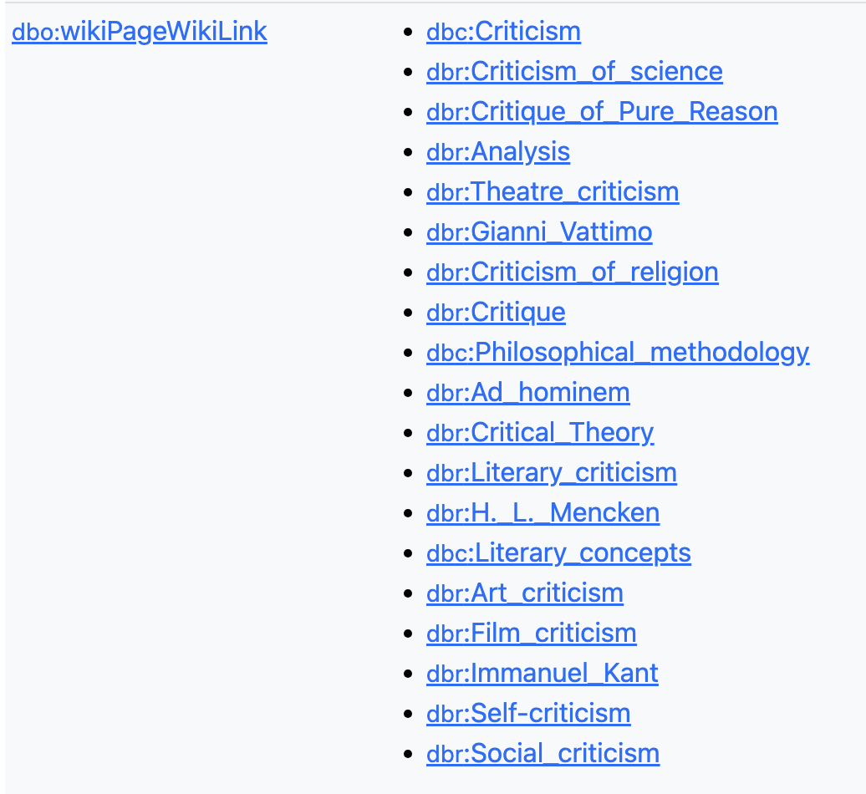
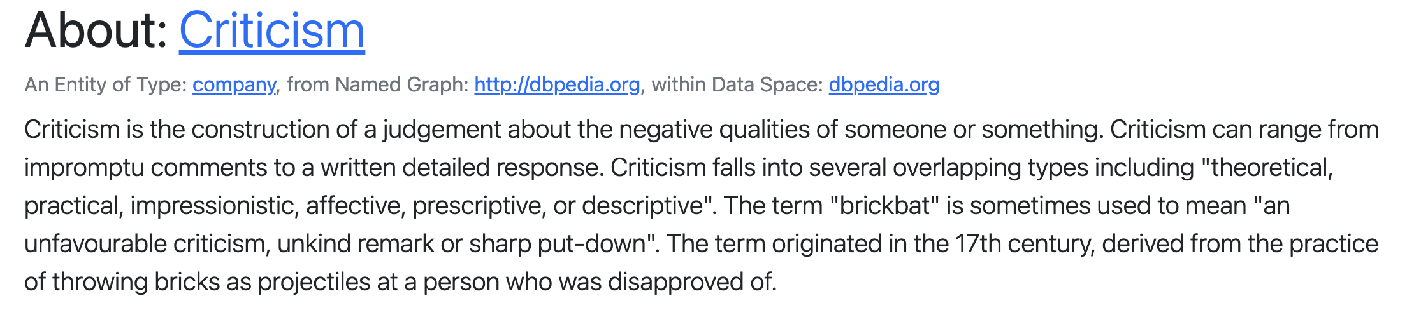
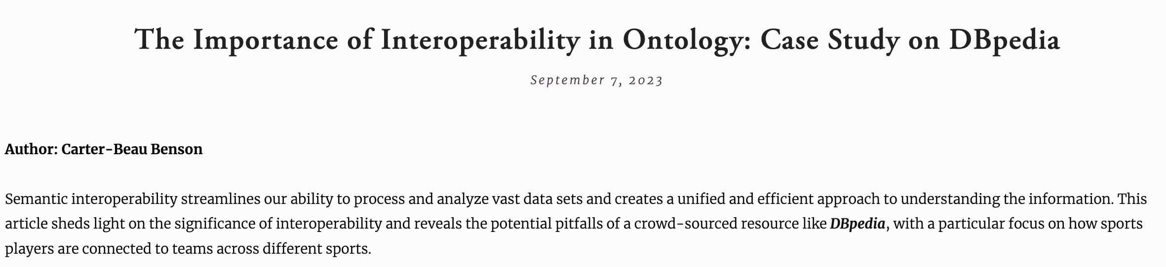

Slide 55
Dbpedia Challenge: https://dbpedia.org/sparql
What is the birthdate of Barack Obama?
What city is the capital of Spain?
What is the highest peak in the U.S.?
What is the release date of the movie “The Dark Knight”?
What country won the FIFA World Cup in 2018?
Who directed the movie “Jurassic Park”?

Slide 56
Group Exercise
Gather into small groups; navigate to DBPedia
Attempt to write SPARQL queries answering the questions posed in the preceding slide
You will be expected to discuss your strategies, queries, and results

Slide 57
Dbpedia Challenge: https://dbpedia.org/sparql
What are the ten most populous cities in China?
What are the birthdates of every U.S. president who served in the 20th century?
What three cities in the U.S. have the highest percentage of foreign-born residents?
Which paintings by Vincent Van Gogh are currently located in museums in the U.S.?
How many rdfs labels include the string “lio”?

Slide 58
Group Exercise
Gather into small groups; navigate to DBPedia
Attempt to write SPARQL queries answering the questions posed in the preceding slide
You will be expected to discuss your strategies, queries, and results

Slide 59
Outline
SPARQL
MITRE D3FEND
Semantic Web Vulnerabilities
Formal Verification Meets Ontology Enginering

Slide 60
Semantic Web Vulnerabilities
Consider the space of vulnerabilities stemming from:
SPARQL Injections patterned on SQL Injections
Logic-Based SPARQL Injection Attacks
There is very little literature on these topics
There are no tools to automate the identification of semantic web vulnerabilities

Slide 61
Semantic Web Vulnerabilities
Consider the space of vulnerabilities stemming from:
SPARQL Injections patterned on SQL Injections
Logic-Based SPARQL Injection Attacks
There is very little literature on these topics
There are no tools to automate the identification of semantic web vulnerabilities

Slide 62
Semantic Web Vulnerabilities
There is very little literature on semantic web vulnerabilities
What little exists attempts to draw parallels between the more widely-discussed SQL Injection vulnerabilities and SPARQL Injections
Though even here researchers tend to ignore SPARQL is a protocol language, and so can interact natively with browsers

Slide 63
Semantic Web Vulnerabilities
There is very little literature on semantic web vulnerabilities
What little exists attempts to draw parallels between the more widely-discussed SQL Injection vulnerabilities and SPARQL Injections
Though even here researchers tend to ignore SPARQL is a protocol language, and so can interact natively with browsers

Slide 64
SQL Injection
‘Injecting’ SQL into a database via input fields from the client-side
Suppose you navigate to a website and input a user ID to a field to return a username; this might generate a SQL query like:
SELECT * FROM Users WHERE UserId = ‘“ + txtUserId + ”’
For a given row in the database, if “row = txtUserId” is true, then the username is returned

Slide 65
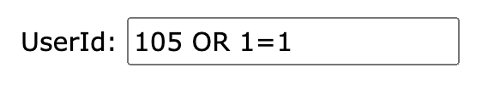
SQL Injection
If users are allowed to enter whatever input they like in the field, one might enter, say, user ID “105” alongside:
Generating the SQL query:
SELECT * FROM Users WHERE UserId = 105 OR 1=1;
Which would return all rows since “OR 1=1” is trivially true

Slide 66
SPARQL Injection
‘Injecting’ SPARQL into a database via input fields from the client-side
Suppose you navigate to a website and input a user ID to a field to return a credit card number; this might generate a SPARQL query like:
SELECT * WHERE {?uri ex:UserId = ‘txtUserId’ ; ex:credit_card_number ?cc . }
Which returns any triples matching txtUserId with a credit card number

Slide 67
SPARQL Injection
Suppose instead of txtUserId a user writes ‘“ . }#’ resulting in the following SPARQL query in the backend:
SELECT * WHERE {?uri ex:UserId = ‘“ . }#’ . ex:credit_card_number ?cc . }
Where # comments out the rest of the query, which may result in unexpected behavior, such as all credit cards numbers being returned

Slide 68
SPARQL Injection
There are clear parallels between SQL and SPARQL injection attacks
Recall, however, that SPARQL is a native protocol language which can interact with your browser
To my knowledge, there is no current research on injection attacks that leverage features of SPARQL that distinguish it from SQL

Slide 69
Semantic Web Vulnerabilities
Consider the space of vulnerabilities stemming from:
SPARQL Injections patterned on SQL Injections
Logic-Based SPARQL Injection Attacks
There is very little literature on these topics
There are no tools to automate the identification of semantic web vulnerabilities

Slide 70
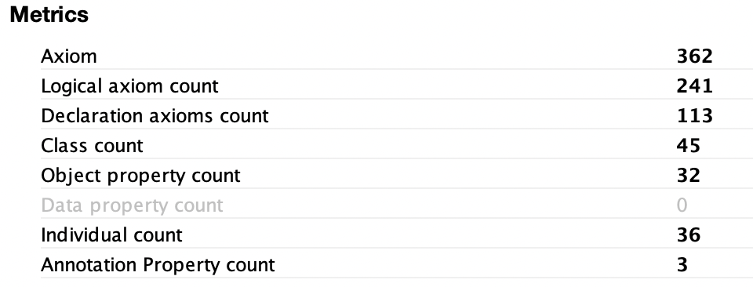
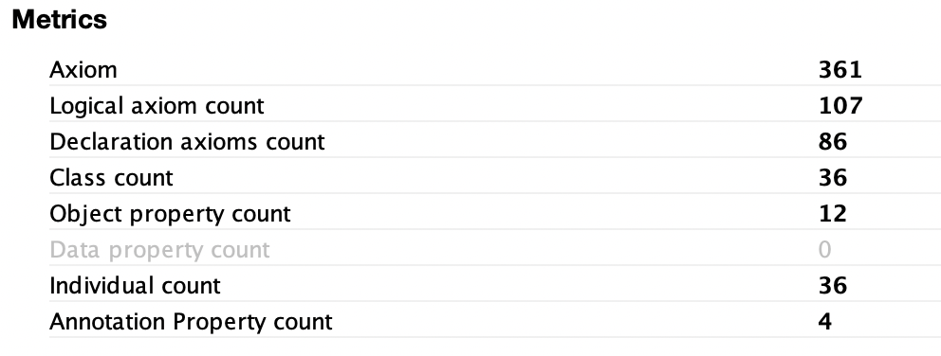
Background: ATM Ontology Generation
Target: Sheng, Yin, et al. "An ontology for decision-making support in air traffic management." Artificial Intelligence in China. Springer, Singapore, 2020. 458-466.
Experiment Description: Two ontologists, independently, reconstructed ontologies according to the specification in the target article. Model checkers used to automate model generation.
Result: The resulting ontologies/models differed in overall structure, number of classes, axioms, and relations, and logical strength.
ATM Ontology #1
ATM Ontology #2

Slide 71
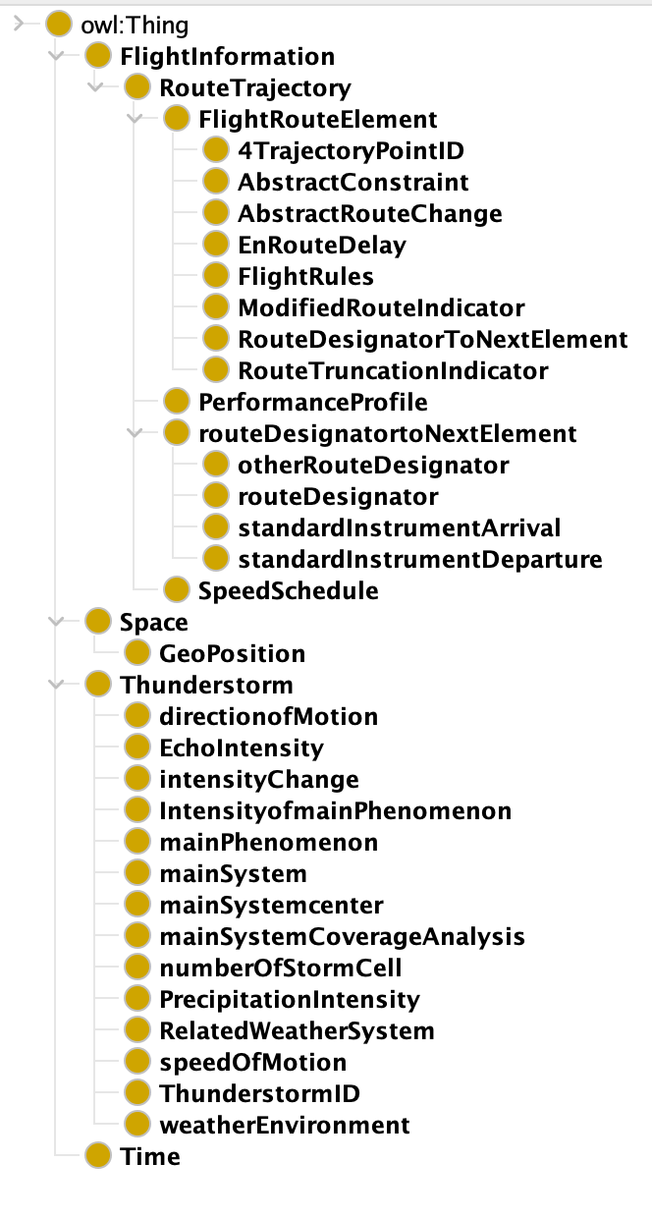
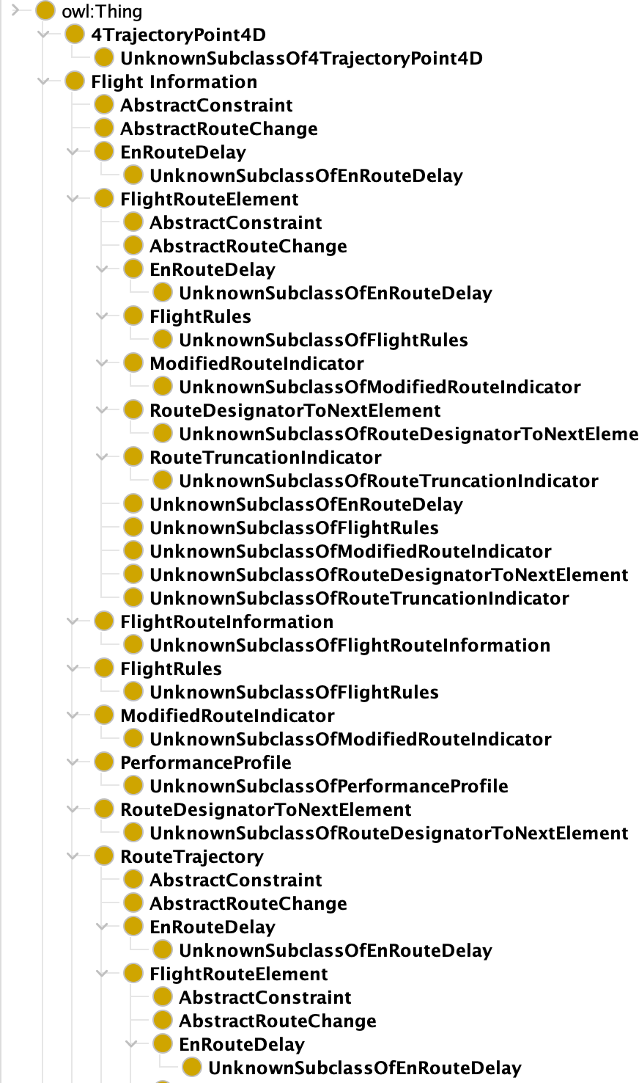
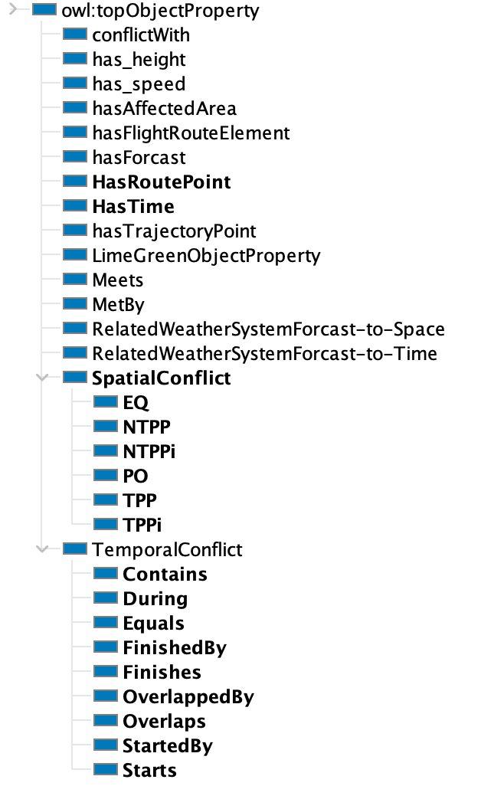
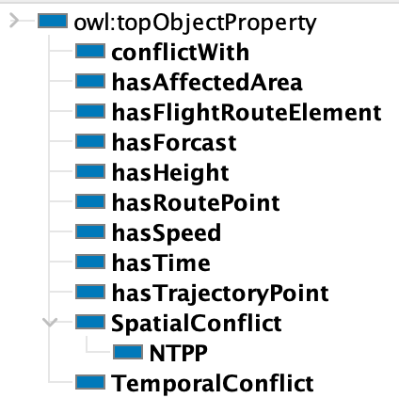
ATM Ontology #1 Classes/Relations
ATM Ontology #2 Classes/Relations

Slide 72
ATM Ontology #1
Mace4 Model
ATM Ontology #2
Mace4 Model
============ STATISTICS ===============
For domain size 37.
Current CPU time: 0.00 seconds (total CPU time: 6.38 seconds).
Ground clauses: seen=26377, kept=26301.
Selections=41044, assignments=41044, propagations=3819, current_models=1.
Rewrite_terms=1531, rewrite_bools=30846, indexes=581.
Rules_from_neg_clauses=0, cross_offs=20.
========== end of statistics ================
========== STATISTICS ==================
For domain size 37.
Current CPU time: 0.00 seconds (total CPU time: 0.67 seconds).
Ground clauses: seen=8172, kept=6728.
Selections=12017, assignments=12017, propagations=5789, current_models=1.
Rewrite_terms=96, rewrite_bools=12510, indexes=14.
Rules_from_neg_clauses=0, cross_offs=0.
========= end of statistics =================

Slide 73
ATM Ontology #1
Mace4 Model
ATM Ontology #2
Mace4 Model
============ STATISTICS ===============
For domain size 37.
Current CPU time: 0.00 seconds (total CPU time: 6.38 seconds).
Ground clauses: seen=26377, kept=26301.
Selections=41044, assignments=41044, propagations=3819, current_models=1.
Rewrite_terms=1531, rewrite_bools=30846, indexes=581.
Rules_from_neg_clauses=0, cross_offs=20.
========== end of statistics ================
========== STATISTICS ==================
For domain size 37.
Current CPU time: 0.00 seconds (total CPU time: 0.67 seconds).
Ground clauses: seen=8172, kept=6728.
Selections=12017, assignments=12017, propagations=5789, current_models=1.
Rewrite_terms=96, rewrite_bools=12510, indexes=14.
Rules_from_neg_clauses=0, cross_offs=0.
========= end of statistics =================
The smallest models generated by Mace4 for each ontology required 37 individuals.

Slide 74
ATM Ontology #1
Mace4 Model
ATM Ontology #2
Mace4 Model
============ STATISTICS ===============
For domain size 37.
Current CPU time: 0.00 seconds (total CPU time: 6.38 seconds).
Ground clauses: seen=26377, kept=26301.
Selections=41044, assignments=41044, propagations=3819, current_models=1.
Rewrite_terms=1531, rewrite_bools=30846, indexes=581.
Rules_from_neg_clauses=0, cross_offs=20.
========== end of statistics ================
========== STATISTICS ==================
For domain size 37.
Current CPU time: 0.00 seconds (total CPU time: 0.67 seconds).
Ground clauses: seen=8172, kept=6728.
Selections=12017, assignments=12017, propagations=5789, current_models=1.
Rewrite_terms=96, rewrite_bools=12510, indexes=14.
Rules_from_neg_clauses=0, cross_offs=0.
========= end of statistics =================
Generating a model for ATM Ontology #1 required significantly more computing time, owing to the additional classes and relations.

Slide 75
ATM Ontology #1
Mace4 Model
ATM Ontology #2
Mace4 Model
============ STATISTICS ===============
For domain size 37.
Current CPU time: 0.00 seconds (total CPU time: 6.38 seconds).
Ground clauses: seen=26377, kept=26301.
Selections=41044, assignments=41044, propagations=3819, current_models=1.
Rewrite_terms=1531, rewrite_bools=30846, indexes=581.
Rules_from_neg_clauses=0, cross_offs=20.
========== end of statistics ================
========== STATISTICS ==================
For domain size 37.
Current CPU time: 0.00 seconds (total CPU time: 0.67 seconds).
Ground clauses: seen=8172, kept=6728.
Selections=12017, assignments=12017, propagations=5789, current_models=1.
Rewrite_terms=96, rewrite_bools=12510, indexes=14.
Rules_from_neg_clauses=0, cross_offs=0.
========= end of statistics =================
Two seasoned ontologists working independently from the same source material will likely generate different formal representations of a given ontology description

Slide 76
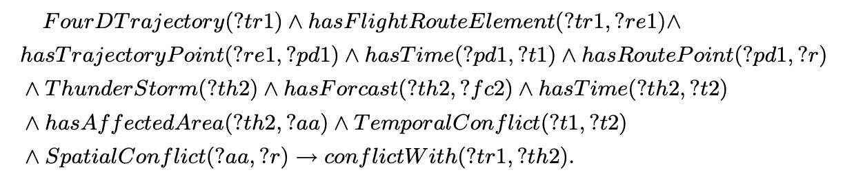
Mace4 & SWRL
Mace4 can be used to represent SWRL rules, such as the following:
Which was a rule included in the ATM paper that was touted as a test of the accuracy of the ATM ontology
If a given trajectory intersects in space and time with the trajectory of a thunderstorm, then that conflict is recorded in the ontology

Slide 77
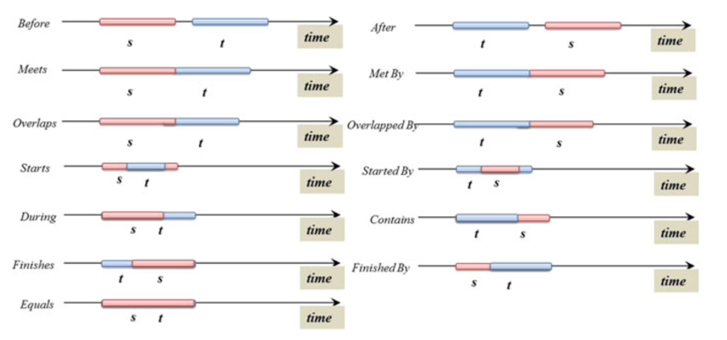
Allen Interval Relations
The authors claim this SWRL rule works because it is based on the Allen Interval Relations, but these relations can’t be formally expressed in OWL

Slide 78
Easy Logic Injection Example
The authors claim this SWRL rule works because it is based on the Allen Interval Relations, but these relations can’t be formally expressed in OWL
For example, before is irreflexive and transitive, but this would lead to non-simple role chains
Most implementations at least assert before is transitive
Ontologies representing Allen Interval Relations are likely susceptible to loop injections on before, i.e. t1 before t1

Slide 79
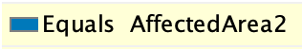
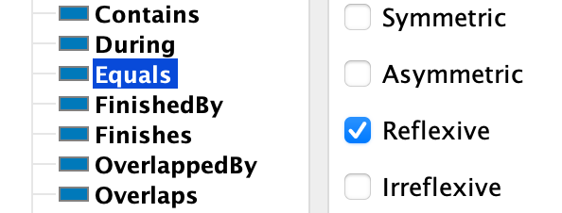
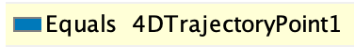
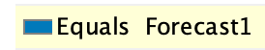
Harder Logic Injection Example
Observe that equals – one of Allen’s relations – is plausibly reflexive
In OWL2, asserting reflexivity of an object property applies globally

Slide 80
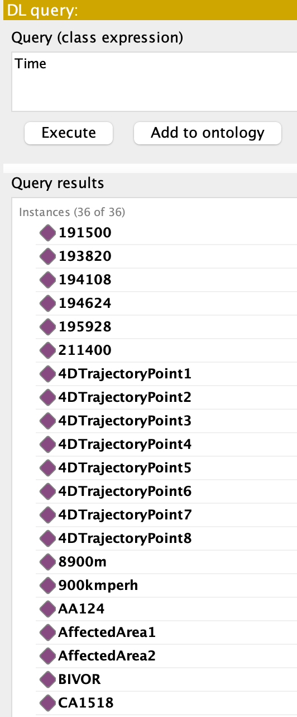
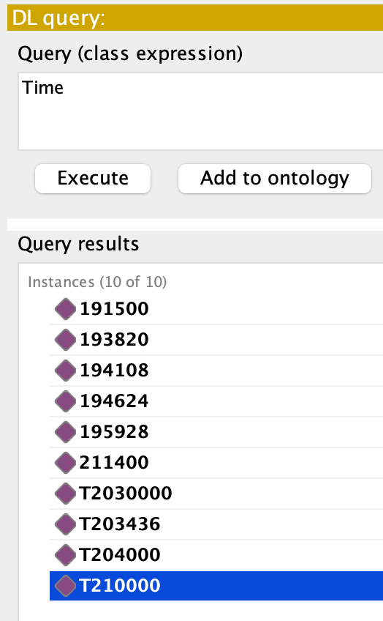
Harder Logic Injection Example
Restricting the domain and range of interval equals does not help, e.g. if restricted to Time, then every instance falls under Time
equals is not reflexive but has domain/range Time
equals is reflexive and has domain/range Time

Slide 81
Reflexivity in OWL2
So, asserting interval equals is reflexive entails – among other things – that the thunderstorm equals itself, as are spatial regions, time zones, etc.
In the ATM ontology, interval equals is a subproperty of TemporalConflict
Moreover, reflexivity is a role constraint that is inherited to parent properties...

Slide 82
Red Team #1
Mace4 was used to identify a model of the ATM ontology in which:
equals is reflexive
SWRL rule identifies too many conflicts

Slide 83
Model Checking Observations
Which is to say, that by using SPARQL to inject reflexivity on equals, it will follow that...
For every instance x in the ontology, there are triples
x TemporalConflict x
x SpatialConflict x

Slide 84
Model Checking Observations
Which is to say, that by using SPARQL to inject reflexivity on equals, it will follow that...
For every instance x in the ontology, there are triples
x TemporalConflict x
x SpatialConflict x
Resulting in the SWRL antecedent satisfied

Slide 85
Red Team #2
Mace4 was used to identify a model of the ATM ontology in which:
equals is reflexive
One conjunct of the SWRL rule is removed
SWRL rule is trivialized

Slide 86

Model Checking Observations
Specifically, by using SPARQL to inject equals as reflexive while removing hasFlightRouteElement entails...
That all instances of any trajectory point are in conflict with a given thunderstorm
Effectively trivializing the SWRL rule

Slide 87
Blue Team
Lesson: Malicious users may manipulate ontology logic to undermine the accuracy of ontological representations and potentially trivialize SWRL rules
Lesson: Malicious users may use SPARQL injection attacks to manipulate ontology logic
Lesson: Automated model checking can be leveraged to identify SPARQL injection vulnerabilities that, if exploited, could significantly impact ontology accuracy

Slide 88
Outline
SPARQL
MITRE D3FEND
Semantic Web Vulnerabilities
Formal Verification Meets Ontology Enginering

Slide 89
Uses of Formal Methods
For some interpretations T, formulas p, and models M:
Is a fixed p true for all T?
Is a fixed p true for some T?
For fixed M what p makes M true?
For fixed M and p does M model p?

Slide 90
Uses of Formal Methods
For some interpretations T, formulas p, and models M:
Is a fixed p true for all T? Proof Checking/Assistants
Is a fixed p true for some T?
For fixed M what p makes M true?
For fixed M and p does M model p?

Slide 91
Uses of Formal Methods
For some interpretations T, formulas p, and models M:
Is a fixed p true for all T? Proof Checking/Assistants
Is a fixed p true for some T? SAT Solving
For fixed M what p makes M true?
For fixed M and p does M model p?

Slide 92
Uses of Formal Methods
For some interpretations T, formulas p, and models M:
Is a fixed p true for all T? Proof Checking/Assistants
Is a fixed p true for some T? SAT Solving
For fixed M what p makes M true? Model Synthesis
For fixed M and p does M model p?

Slide 93
Uses of Formal Methods
For some interpretations T, formulas p, and models M:
Is a fixed p true for all T? Proof Checking/Assistants
Is a fixed p true for some T? SAT Solving
For fixed M what p makes M true? Model Synthesis
For fixed M and p does M model p? Model Checking

Slide 94
Uses of Formal Methods
For some interpretations T, formulas p, and models M:
Is a fixed p true for all T? Proof Checking/Assistants
Is a fixed p true for some T? SAT Solving
For fixed M what p makes M true? Model Synthesis
For fixed M and p does M model p? Model Checking

Slide 95
Formal Verification
Formal verification involves constructing an intended model of some system architecture, such as hardware, software, communication protocols, business logic, etc...
...described by a specification in a formal language...
...so that automated model checking tools can be used to determine whether a formal model of the specification satisfies the intended model of the architecture

Slide 96
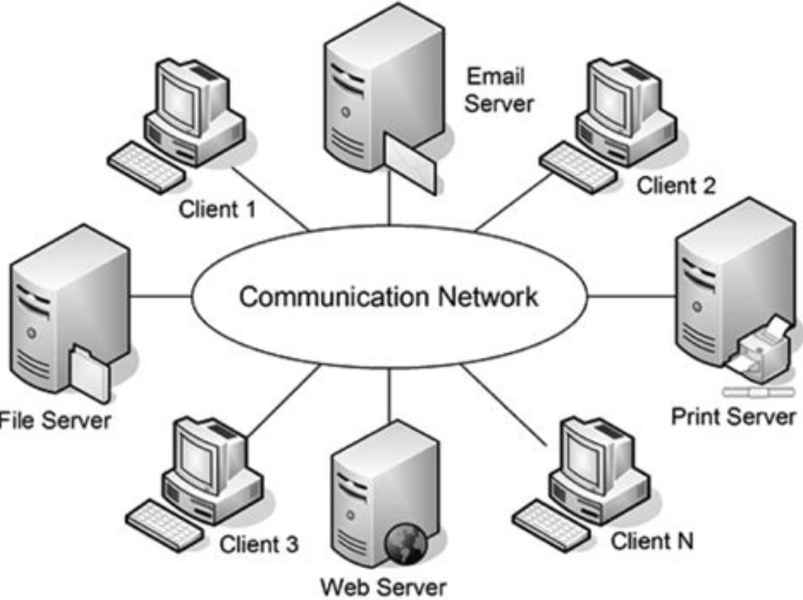
Key Observation
Ontology artifacts are often components of distributed, concurrent systems
Distributed System – Connected sub-systems lacking access to a global memory
Ontologies are being used more and more often to address coordination, reasoning, integration, and collaboration issues that arise in distributed systems

Slide 97
Key Observation
For example, OWL2 cannot express the Allen Interval Relations but an ontology artifact using before and meets embedded in a larger system may behave as if, say, before and meets are irreflexive
Modeling the larger system is warranted...

Slide 98
Caveat: Distributed System
Distributed System – Connected sub-systems lacking access to a global memory
For distributed systems, failure of a sub-system you don’t even know exists, can render your local sub-system unusuable
“Everything about distributed systems is terrible” – Hillel Wayne

Slide 99
Distributed System Faults
Faults – Disruptions in expected behavior classified as:
Permanent – Persists until corrected
Intermittent – Occur, vanish, occur
Transient – Occur, self-correct
Any of these can be:
Fail-Silent – Failure produces no bad output
Byzantine – Continues to run but
produces incorrect results

Slide 100
Distributed System Faults
Faults – Disruptions in expected behavior classified as:
Permanent – Persists until corrected
Intermittent – Occur, vanish, occur
Transient – Occur, self-correct
Any of these can be:
Fail-Silent – Failure produces no bad output
Byzantine – Continues to run but
produces incorrect results

Slide 101


Byzantine Failure
Drone swarm in coordinated flight. Each drone sends relative position data to others. Suppose Drone A experiences a Byzantine failure such that it sends inaccurate, inconsistent, data to other drones. For example, the Drone A sends “I am ascending” to drone B and “I am descending” to Drone C.

Slide 102
Temporal Logic of Actions+
TLA+ is a language used in formal verification to represent distributed concurrent systems as formal specifications
Bundled with model checker, proof-assistant, and parser maintained by Leslie Lamport: https://lamport.azurewebsites.net/tla/high-level-view.html
Supported in Visual Studio Code: https://marketplace.visualstudio.com/items?itemName=alygin.vscode-tlaplus

Slide 103


Temporal Logic of Actions+
TLA+ is a language used in formal verification to represent distributed concurrent systems as formal specifications
Bundled with model checker, proof-assistant, and parser maintained by Leslie Lamport: https://lamport.azurewebsites.net/tla/high-level-view.html
Supported in Visual Studio Code: https://marketplace.visualstudio.com/items?itemName=alygin.vscode-tlaplus

Slide 104
Temporal Logic of Actions+
TLA+ can be used to represent all possible states of the system; byzantine faults can be identified in the design stage.
A formal specification of the system will consist of:
A finite set of states.
A subset that includes an initial state.
A subset that includes an ending state.
A transition relation that describes all states that can be reached incrementally.

Slide 105
Specification Properties to Check
Safety – Proposition ensuring invalid states are not reachable.
Deadlock – Safety proposition ensuring no dead end state is reached.

Slide 106
Specification Properties to Check
Safety – Proposition ensuring invalid states are not reachable.
Deadlock – Safety proposition ensuring no dead end state is reached.
Violation of Deadlock
Process A requires resource from Process B before acting and Process B requires resource from Process A before acting

Slide 107
Specification Properties to Check
Liveness – Proposition ensuring states that should occur.
Termination – Liveness proposition ensuring end state is reached.
Weak Fairness – Liveness proposition ensuring continuously enabled action occurs.
Strong Fairness – Liveness proposition ensuring continually enabled action occurs.

Slide 108
Specification Properties to Check
Liveness – Proposition ensuring states that should occur.
Termination – Liveness proposition ensuring end state is reached.
Weak Fairness – Liveness proposition ensuring continuously enabled action occurs.
Strong Fairness – Liveness proposition ensuring continually enabled action occurs.
Violations of Termination
Distributed system crashes or begins an infinite loop

Slide 109
Specification Properties to Check
Liveness – Proposition ensuring states that should occur.
Termination – Liveness proposition ensuring end state is reached.
Weak Fairness – Liveness proposition ensuring continuously enabled action occurs.
Strong Fairness – Liveness proposition ensuring continually enabled action occurs.
If you visit a museum repeatedly then it’s fair that you make a donation
FGp → Fq

Slide 110
Specification Properties to Check
Liveness – Proposition ensuring states that should occur.
Termination – Liveness proposition ensuring end state is reached.
Weak Fairness – Liveness proposition ensuring continuously enabled action occurs.
Strong Fairness – Liveness proposition ensuring continually enabled action occurs.
If you’ve been occupying a table for an hour then you must order food. GFp → Fq

Slide 111

Traffic Light
Suppose we are tasked with specifying a car waiting at, then driving through, a traffic light. Assume there are only two processes in the system:
The traffic light cycles through red, yellow, and green.
A car waits until the light is green before driving.

Slide 112
NextColor
Color == {"red", "yellow", "green"}
(* The set of available traffic light colors *)
NextColor(c) == CASE c = "red" -> "yellow"
[] c = "yellow" -> "green"
[] c = "green" -> "red"
(* States that if the current color 'c' is red, then at the next state it will be yellow...
...and if it is yellow, then at the next state it will be green, and so on.
NOTE: The '[]' here is not a temporal operator, but is part of the CASE syntax to
separate conditions *)

Slide 113
NextColor
TLA+ keyword such that: 1. If no case matches and there is no default, an error is thrown. 2. If more than one case matches, the behavior is undefined. 3. It tries to match cases sequentially.
Color == {"red", "yellow", "green"}
(* The set of available traffic light colors *)
NextColor(c) == CASE c = "red" -> "yellow"
[] c = "yellow" -> "green"
[] c = "green" -> "red"
(* States that if the current color 'c' is red, then at the next state it will be yellow...
...and if it is yellow, then at the next state it will be green, and so on.
NOTE: The '[]' here is not a temporal operator, but is part of the CASE syntax to
separate conditions *)

Slide 114
NextColor
Color == {"red", "yellow", "green"}
(* The set of available traffic light colors *)
NextColor(c) == CASE c = "red" -> "yellow"
[] c = "yellow" -> "green"
[] c = "green" -> "red"
(* States that if the current color 'c' is red, then at the next state it will be yellow...
...and if it is yellow, then at the next state it will be green, and so on.
NOTE: The '[]' here is not a temporal operator, but is part of the CASE syntax to
separate conditions *)

Slide 115
Init
Init == /\ at_light = TRUE
/\ light = "red"
/\ pc = [self \in ProcSet |-> CASE self = "light" -> "Cycle"
[] self = "car" -> "Drive"]
(* Initial state of the system. A car is initially at the light. The light is red. pc is a function
from the variable 'self' to 'ProcSet', i.e. for each process in ProcSet...
...if the process is "light" then the next action is "Cycle"...
...and if the process is "car" then the next action is "Drive" *)

Slide 116
Init
VARIABLES ‘at_light’ stores whether the car is at the light ‘light’ stores the light color
‘pc’ stores counters for two processes
Init == /\ at_light = TRUE
/\ light = "red"
/\ pc = [self \in ProcSet |-> CASE self = "light" -> "Cycle"
[] self = "car" -> "Drive"]
(* Initial state of the system. A car is initially at the light. The light is red. pc is a function
from the variable 'self' to 'ProcSet', i.e. for each process in ProcSet...
...if the process is "light" then the next action is "Cycle"...
...and if the process is "car" then the next action is "Drive" *)

Slide 117
Init
Process Set, i.e. the union of “light” and “car” processes
Init == /\ at_light = TRUE
/\ light = "red"
/\ pc = [self \in ProcSet |-> CASE self = "light" -> "Cycle"
[] self = "car" -> "Drive"]
(* Initial state of the system. A car is initially at the light. The light is red. pc is a function
from the variable 'self' to 'ProcSet', i.e. for each process in ProcSet...
...if the process is "light" then the next action is "Cycle"...
...and if the process is "car" then the next action is "Drive" *)

Slide 118
Init
Recall, CASE checks conditions sequentially, starting with the first.
Init == /\ at_light = TRUE
/\ light = "red"
/\ pc = [self \in ProcSet |-> CASE self = "light" -> "Cycle"
[] self = "car" -> "Drive"]
(* Initial state of the system. A car is initially at the light. The light is red. pc is a function
from the variable 'self' to 'ProcSet', i.e. for each process in ProcSet...
...if the process is "light" then the next action is "Cycle"...
...and if the process is "car" then the next action is "Drive" *)

Slide 119
Cycle
Cycle == /\ pc["light"] = "Cycle"
/\ IF at_light
THEN /\ light' = NextColor(light)
/\ pc' = [pc EXCEPT !["light"] = "Cycle"]
ELSE /\ pc' = [pc EXCEPT !["light"] = "Done"]
/\ light' = light
/\ UNCHANGED at_light
(* When triggered, at_light=TRUE, then the next state changes to the next
color according to NextColor and update the counter pc from "light" to
"Cycle", i.e. in the next state the traffic light should continue cycling.
Otherwise, at_light=FALSE, update counter to "Done" and the light color
stays the same. The "Cycle" operator does not change the status of at_light.*)

Slide 120
Cycle
This is a state description, i.e. a description of possible states
Cycle == /\ pc["light"] = "Cycle"
/\ IF at_light
THEN /\ light' = NextColor(light)
/\ pc' = [pc EXCEPT !["light"] = "Cycle"]
ELSE /\ pc' = [pc EXCEPT !["light"] = "Done"]
/\ light' = light
/\ UNCHANGED at_light
(* When triggered, at_light=TRUE, then the next state changes to the next
color according to NextColor and update the counter pc from "light" to
"Cycle", i.e. in the next state the traffic light should continue cycling.
Otherwise, at_light=FALSE, update counter to "Done" and the light color
stays the same. The "Cycle" operator does not change the status of at_light.*)

Slide 121
Cycle
This is the first condition from the CASE clause in Init
Cycle == /\ pc["light"] = "Cycle"
/\ IF at_light
THEN /\ light' = NextColor(light)
/\ pc' = [pc EXCEPT !["light"] = "Cycle"]
ELSE /\ pc' = [pc EXCEPT !["light"] = "Done"]
/\ light' = light
/\ UNCHANGED at_light
(* When triggered, at_light=TRUE, then the next state changes to the next
color according to NextColor and update the counter pc from "light" to
"Cycle", i.e. in the next state the traffic light should continue cycling.
Otherwise, at_light=FALSE, update counter to "Done" and the light color
stays the same. The "Cycle" operator does not change the status of at_light.*)

Slide 122
Cycle
Indicates the next step for light; strictly speaking,
light’ a relation between time points
Cycle == /\ pc["light"] = "Cycle"
/\ IF at_light
THEN /\ light' = NextColor(light)
/\ pc' = [pc EXCEPT !["light"] = "Cycle"]
ELSE /\ pc' = [pc EXCEPT !["light"] = "Done"]
/\ light' = light
/\ UNCHANGED at_light
(* When triggered, at_light=TRUE, then the next state changes to the next
color according to NextColor and update the counter pc from "light" to
"Cycle", i.e. in the next state the traffic light should continue cycling.
Otherwise, at_light=FALSE, update counter to "Done" and the light color
stays the same. The "Cycle" operator does not change the status of at_light.*)

Slide 123
Cycle
The light cycling should not affect
whether a car is at the light
Cycle == /\ pc["light"] = "Cycle"
/\ IF at_light
THEN /\ light' = NextColor(light)
/\ pc' = [pc EXCEPT !["light"] = "Cycle"]
ELSE /\ pc' = [pc EXCEPT !["light"] = "Done"]
/\ light' = light
/\ UNCHANGED at_light
(* When triggered, at_light=TRUE, then the next state changes to the next
color according to NextColor and update the counter pc from "light" to
"Cycle", i.e. in the next state the traffic light should continue cycling.
Otherwise, at_light=FALSE, update counter to "Done" and the light color
stays the same. The "Cycle" operator does not change the status of at_light.*)

Slide 124
Drive
Drive == /\ pc["car"] = "Drive"
/\ light = "green"
/\ at_light' = FALSE
/\ pc' = [pc EXCEPT !["car"] = "Done"]
/\ light' = light
(* Describes a state in which the light is green, the car drives away, i.e.
at_light=FALSE, and the counter is updated to "Done" while the
light remains the same color. *)

Slide 125
Drive
Second condition of the CASE clause in Init
Drive == /\ pc["car"] = "Drive"
/\ light = "green"
/\ at_light' = FALSE
/\ pc' = [pc EXCEPT !["car"] = "Done"]
/\ light' = light
(* Describes a state in which the light is green, the car drives away, i.e.
at_light=FALSE, and the counter is updated to "Done" while the
light remains the same color. *)

Slide 126
Drive
Changes at_light so that next iteration the car will have driven away
Drive == /\ pc["car"] = "Drive"
/\ light = "green"
/\ at_light' = FALSE
/\ pc' = [pc EXCEPT !["car"] = "Done"]
/\ light' = light
(* Describes a state in which the light is green, the car drives away, i.e.
at_light=FALSE, and the counter is updated to "Done" while the
light remains the same color. *)

Slide 127
Drive
But light remains the same color during this state.
Drive == /\ pc["car"] = "Drive"
/\ light = "green"
/\ at_light' = FALSE
/\ pc' = [pc EXCEPT !["car"] = "Done"]
/\ light' = light
(* Describes a state in which the light is green, the car drives away, i.e.
at_light=FALSE, and the counter is updated to "Done" while the
light remains the same color. *)

Slide 128
Terminating
Terminating == /\ \A self \in ProcSet: pc[self] = "Done"
/\ UNCHANGED vars
(* The state transition description indicating when all processes are marked
"Done" and variables are unchanged.
NOTE: This describes what can happen, in contrast to the "Terminating"
liveness property below which describes what must happen. *)

Slide 129
Terminating
In other words, description of the end state.
Terminating == /\ \A self \in ProcSet: pc[self] = "Done"
/\ UNCHANGED vars
(* The state transition description indicating when all processes are marked
"Done" and variables are unchanged.
NOTE: This describes what can happen, in contrast to the "Terminating"
liveness property below which describes what must happen. *)

Slide 130
Terminating
Universal quantifier, i.e. all self in ProcSet...set to “Done”
Terminating == /\ \A self \in ProcSet: pc[self] = "Done"
/\ UNCHANGED vars
(* The state transition description indicating when all processes are marked
"Done" and variables are unchanged.
NOTE: This describes what can happen, in contrast to the "Terminating"
liveness property below which describes what must happen. *)

Slide 131
Spec
Spec == /\ Init /\ [][Next]_vars /\ WF_vars(Cycle) /\ SF_vars(Drive)
(* The full system spec. Init indicates the system begins in the initial state.
[][Next]_vars is a safety property indicating every step of the system is
described by "Next” and variables at_light, light, and pc.
WF_vars(Cycle) is a liveness property stating "Cycle" is 'weakly fair', i.e. if
the light can change color then it eventually will change color.
SF_vars(Drive) is liveness property stating "Drive" is 'strongly fair', so if
"Drive" is enabled indefinitely even if not continuously, then it will eventually
execute, i.e. if the light turns green infinitely, the car will eventually drive. *)

Slide 132
Spec
Next == Cycle \/ Drive \/ Terminating
Spec == /\ Init /\ [][Next]_vars /\ WF_vars(Cycle) /\ SF_vars(Drive)
(* The full system spec. Init indicates the system begins in the initial state.
[][Next]_vars is a safety property indicating every step of the system is
described by "Next” and variables at_light, light, and pc.
WF_vars(Cycle) is a liveness property stating "Cycle" is 'weakly fair', i.e. if
the light can change color then it eventually will change color.
SF_vars(Drive) is liveness property stating "Drive" is 'strongly fair', so if
"Drive" is enabled indefinitely even if not continuously, then it will eventually
execute, i.e. if the light turns green infinitely, the car will eventually drive. *)

Slide 133
Spec
Liveness properties ensure intended events do occur; these rule out stuttering, i.e. iterations where nothing changes.
Spec == /\ Init /\ [][Next]_vars /\ WF_vars(Cycle) /\ SF_vars(Drive)
(* The full system spec. Init indicates the system begins in the initial state.
[][Next]_vars is a safety property indicating every step of the system is
described by "Next” and variables at_light, light, and pc.
WF_vars(Cycle) is a liveness property stating "Cycle" is 'weakly fair', i.e. if
the light can change color then it eventually will change color.
SF_vars(Drive) is liveness property stating "Drive" is 'strongly fair', so if
"Drive" is enabled indefinitely even if not continuously, then it will eventually
execute, i.e. if the light turns green infinitely, the car will eventually drive. *)

Slide 134
Spec
Suppose light cycles at each step. Drive is enabled when the light is green. If the next state changes light to red, ad infinitum, then the car will never move. Strong Fairness requires the car move if repeatedly enabled.
Spec == /\ Init /\ [][Next]_vars /\ WF_vars(Cycle) /\ SF_vars(Drive)
(* The full system spec. Init indicates the system begins in the initial state.
[][Next]_vars is a safety property indicating every step of the system is
described by "Next” and variables at_light, light, and pc.
WF_vars(Cycle) is a liveness property stating "Cycle" is 'weakly fair', i.e. if
the light can change color then it eventually will change color.
SF_vars(Drive) is liveness property stating "Drive" is 'strongly fair', so if
"Drive" is enabled indefinitely even if not continuously, then it will eventually
execute, i.e. if the light turns green infinitely, the car will eventually drive. *)

Slide 135
TLA+ Model Checker: TLC
We can specify properties we would like to check the specification against.
For example, we can use the model checker TLC to verify that the Terminating state is eventually reached
Termination == <>(\A self \in ProcSet: pc[self] = "Done")

Slide 136
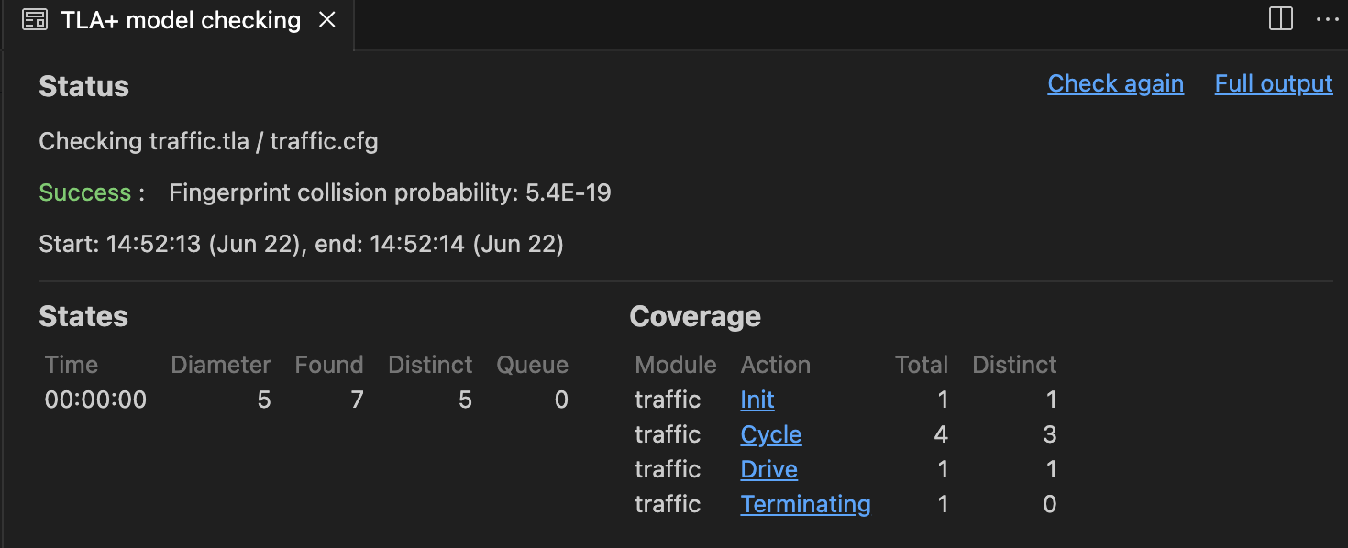
Successful Model

Slide 137
Successful Model
Successful model was identified, having 7 states - 5 of which were unique – ultimately in which Cycle and Drive were set to “Done”

Slide 138
TLA+ Model Checker: TLC
We can also use TLC to identify countermodels, leveraging the same invariant checking resources.
For example, we can check whether the light is eventually, always red:
Event4 == <>[](light = “red")

Slide 139
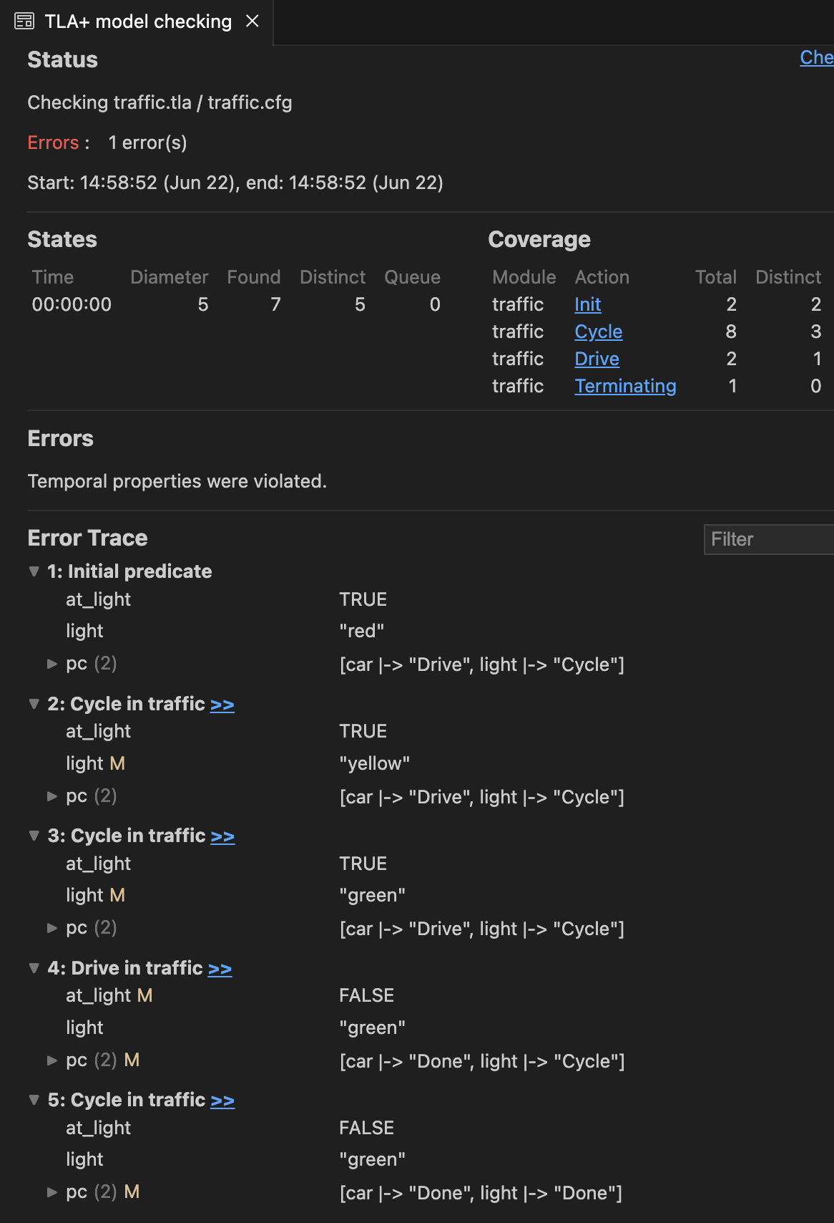
Countermodel

Slide 140
Countermodel
Countermodel identified having 7 states – 5 of which are unique

Slide 141
Countermodel
After light turns green and car drives away, our specification allows the light to remain green...so not eventually always red

Slide 142
Back to Ontologies
Recall, SWRL rules can be represented in OWL, such as the following:
Which was a rule included in the ATM paper that was touted as a test of the accuracy of the ATM ontology
If a given trajectory intersects in space and time with the trajectory of a thunderstorm, then that conflict is recorded in the ontology

Slide 143
Back to Ontologies
TLA+ can be used to model rules in an ontology as formal specifications, in the interest of identifying countermodels stemming from iterated rule application
Ontologies and accompanying rules can be translated into TLA+ in a rather straightforward manner

Slide 144
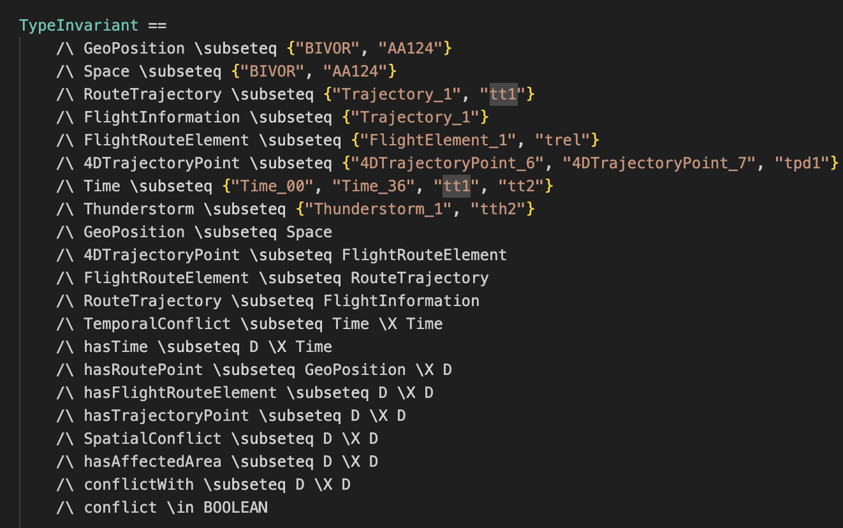
Predicates for ATM Ontology in TLA+ Syntax

Slide 145
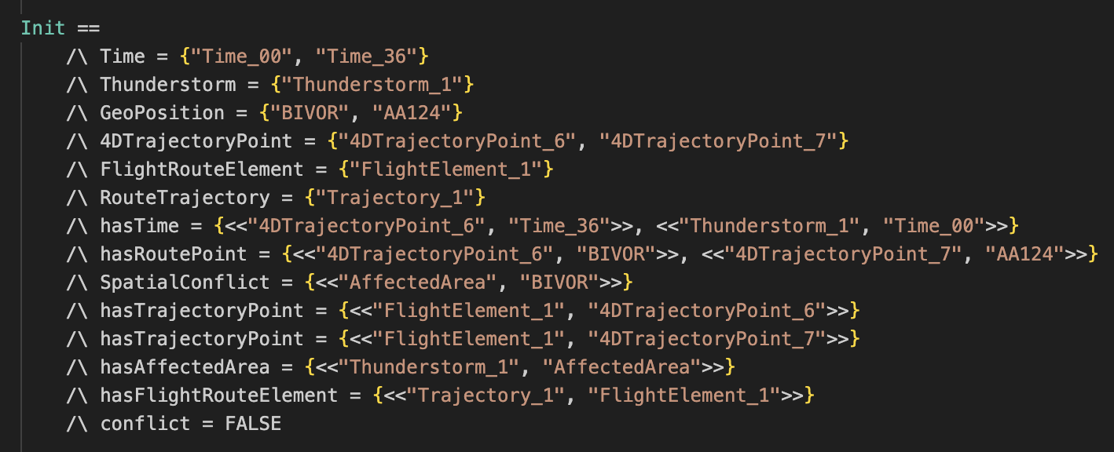
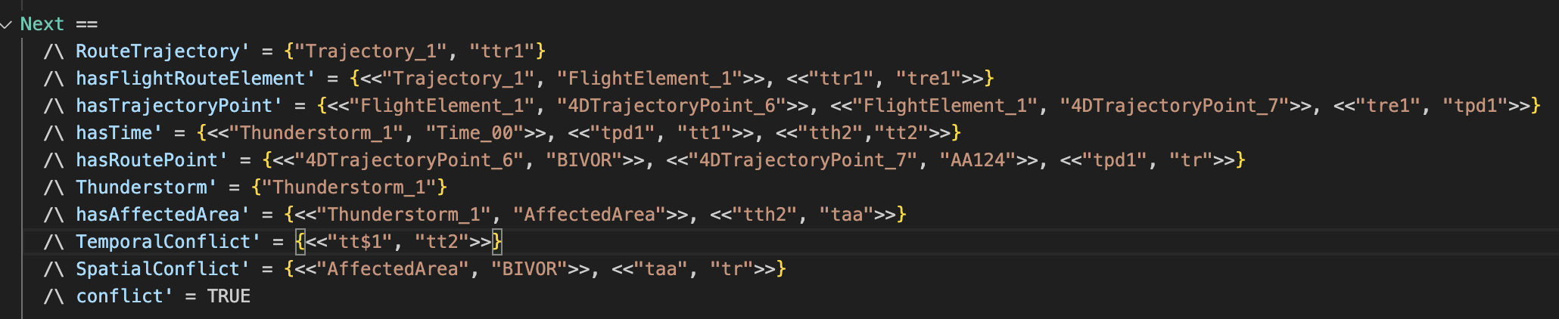
ATM Ontology Provides
Initial Conditions
SWRL Rule Provides
Next State

Slide 146
Novelty
To my knowledge, very little research has been conducted on formal verification applied to software
And there has been no research that I can find exploring the intersection of formal verification and ontology use/development
Given that ontologies are often used in larger software ecosystems, identifying consequences of iterated applications of rules warrants our attention

Slide 147
Readings
The Ontology of Espionage in Reality and Fiction
Toward a Knowledge Graph of Cybersecurity Countermeasures
A deliberately insecure RDF-based Semantic Web application
Ontology for ATT&CK

